Slide 1



JavaScript under the hood
Conclusion
Functions
JS Objects
Engines
History
call(),apply(),bind()
Execution Context
Intro
JavaScript under the hood
Girum Asfaw

Slide 2

Me
Topics
Conclusion
Functions
JS Objects
Engines
call(),apply(),bind()
History
Intro
Execution Context
Almost a year at Ordina
Aspiring to use JS for full stack
Love React
I’m working for ASML
I’m Girum
Studied IT in Ethiopia

Slide 3
Me
Topics
Includes
Hoisting
Execution context
Execution stack
Variable object
Scope chain
The value of this
IIFE
Closure
Not covered
ES6
WebAPIs
Conclusion
Functions
JS Objects
Engines
call(),apply(),bind()
History
Intro
Execution Context

Slide 4
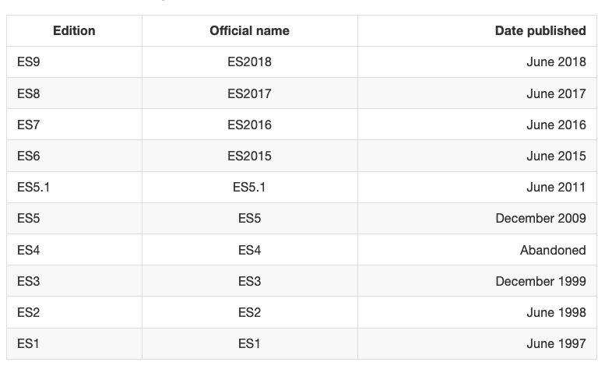
Mosaic Netscape
Netscape navigator
Mocha
IE
VS
NN
ECMA-262
ECMAScript
Conclusion
LiveScript
Functions
JS Objects
Engines
History
call(),apply(),bind()
Execution Context
JavaScript
Intro
Mosiac Communication
The browser war
ECMA International

Slide 5
Known engines
Execution
Chrome V8 from Google is the most used engine. Google Chrome and the many other Chromium-based browsers use it, as do applications built with CEF, Electron, or any other framework that embeds Chromium. Other uses include the Node.js runtime system.
SpiderMonkey is developed by Mozilla for use in Firefox and its forks. The GNOME Shell uses it for extension support.
JavaScriptCore is Apple's engine for its Safari browser. Other WebKit-based browsers also use it. KJS from KDE was the starting point for its development.^{[9]}
Chakra is the current engine of the Microsoft Edge browser, forked from the same-named engine of Internet Explorer. However, Microsoft is now rebuilding Edge as a Chromium-based browser,^{[10][11]} so it will be using V8 instead of Chakra. Internet Explorer will continue to use its version of Chakra.
Conclusion
Functions
JS Objects
Engines
History
call(),apply(),bind()
Execution Context
Intro

Slide 6
Known engines
Execution
JS Engine
JS
Parser
AST
Machine code
Run
Conclusion
Functions
JS Objects
Engines
History
call(),apply(),bind()
Execution Context
Intro
abstract syntax tree

Slide 7
Variable Hoisting
Function Hoisting
Scope
Execution context
?
console.log('The value of a is', a);
var a;
console.log('The value of a is', a);
a = 14;
console.log('The value of a is', a);
Conclusion
Functions
JS Objects
Engines
History
call(),apply(),bind()
Execution Context
Intro

Slide 8
Variable Hoisting
Function Hoisting
Scope
Execution context
Source of confusion
… variable declaration is moved to the top of the function or global code.
Sounds as if the variable and function declarations are physically moved to the top of the code
— MDN web docs
Hoisting is JavaScript’s default behavior of moving declarations to the top.
— W3Schools
Conclusion
Functions
JS Objects
Engines
History
call(),apply(),bind()
Execution Context
Intro
JS Engine
Memory creation phase
Execution phase
Note: let/const/class declarations behave differently

Slide 9
Variable Hoisting
Function Hoisting
Scope
Execution context
console.log(x)
// ReferenceError: x is not defined
console.log(x)
var x
// undefined
console.log(x)
var x = 10
// undefined
Initializations are not hoisted
Creation phase
Declaration of x (var x) initialized to undefined
Initialization (=10) do nothing
Execution phase
The value of x is undefined
Conclusion
Functions
JS Objects
Engines
History
call(),apply(),bind()
Execution Context
Intro
console.log(x)
var x = 10
console.log(x)
// undefined
// 10

Slide 10
Variable Hoisting
Function Hoisting
Scope
Execution context
?
console.log('The value of a is', a);
var a;
console.log('The value of a is', a);
a = 14;
console.log('The value of a is', a);
Conclusion
Functions
JS Objects
Engines
History
call(),apply(),bind()
Execution Context
Intro
The value of a is undefined
The value of a is undefined
The value of a is 14

Slide 11
Variable Hoisting
Function Hoisting
Scope
Execution context
sayHello()
function sayHello () {
function hello () {
console.log('Hello!’)
}
hello()
function hello () {
console.log('Hey!')
}
}
sayHello()
function sayHello () {
function hello () {
console.log('Hello!’)
}
hello()
var hello = function () {
console.log('Hey!')
}
}
Conclusion
Functions
JS Objects
Engines
History
call(),apply(),bind()
Execution Context
Intro
sayHello()
var sayHello = function () {
function hello () {
console.log('Hello!’)
}
hello()
function hello () {
console.log('Hey!')
}
}

Slide 12
Variable Hoisting
Function Hoisting
Scope
Execution context
console.log(x)
var x
x is available before declaration
sayHello()
function sayHello () {
console.log('Hello!')
}
Conclusion
Functions
JS Objects
Engines
History
call(),apply(),bind()
Execution Context
Intro
Same logic applies to function declaration
The JavaScript engine recognized a function declaration by the function keyword and hoisted it — in other words, the JavaScript engine made the function available by putting it into the memory, before moving on.

Slide 13
Variable Hoisting
Function Hoisting
Scope
Execution context
sayHello()
var sayHello = function () {
console.log('Hello!')
}
TypeError: sayHello is not a function
Conclusion
Functions
JS Objects
Engines
History
call(),apply(),bind()
Execution Context
Intro
Defining a function
Function Declaration
Function Expression
function sayHello() {
console.log('Hello!')
}
sayHello()
var sayHello = function() {
console.log('Hello!')
}
sayHello()

Slide 14
Variable Hoisting
Function Hoisting
Scope
Execution context
sayHello()
function sayHello () {
var hello = function () {
console.log('Hello!’)
}
hello()
var hello = function () {
console.log('Hey!')
}
}
sayHello()
function sayHello () {
var hello = function () {
console.log('Hello!’)
}
hello()
function hello () {
console.log('Hey!')
}
}
Conclusion
Functions
JS Objects
Engines
History
call(),apply(),bind()
Execution Context
Intro
Hello!
Hello!

Slide 15
Variable Hoisting
Function Hoisting
Scope
Execution context
?
var greet = 'Hello!'
function sayHi () {
console.log('2: ', greet)
var greet = 'Hoi!'
console.log('3: ', greet)
}
console.log('1: ', greet)
sayHi()
console.log('4: ', greet)
Conclusion
Functions
JS Objects
Engines
History
call(),apply(),bind()
Execution Context
Intro
Understanding of hoisting and scope is a must to get this one right.

Slide 16
Variable Hoisting
Function Hoisting
Scope
Execution context
var greet = 'Hello!'
function sayHi () {
console.log('1: ', greet)
}
sayHi()
console.log('2: ', greet)
1: Hello!
2: Hello!
Conclusion
Functions
JS Objects
Engines
History
call(),apply(),bind()
Execution Context
Intro

Slide 17
Variable Hoisting
Function Hoisting
Scope
Execution context
function sayHi () {
var greet = 'Hello!'
console.log('1: ', greet)
}
sayHi()
console.log('2: ', greet)
1: Hello!
ReferenceError: greet is not defined
Conclusion
Functions
JS Objects
Engines
History
call(),apply(),bind()
Execution Context
Intro
Scopes
Global
Local
- Outermost scope and is pre-defined
- Created within the global scope
- Created by the JavaScript engine
- Accessed and modified from any other scope
- Every time a function is declared, a new local scope gets created
- Accessed and modified within the same scope.

Slide 18
Variable Hoisting
Function Hoisting
Scope
Execution context
// Global scope
var greet = 'Hello!' // Globally scoped
function changeGreet () {
console.log('2: ', greet) // Accessible
greet = 'Hey!' // Modified
console.log('3: ', greet) // Accessible
}
console.log('1: ', greet) // Accessible
changeGreet()
console.log('4: ', greet) // Accessible
1: Hello!
2: Hello!
3: Hey!
4: Hey!
Conclusion
Functions
JS Objects
Engines
History
call(),apply(),bind()
Execution Context
Intro
// Global scope
function sayHi () {
// Local scope
var greet = 'Hello!' // Locally scoped
console.log('1: ', greet) // Accessible within the same scope
greet = 'Hey!' // Modified within the same scope
console.log('2: ', greet) // Accessible within the same scope
}
sayHi()
console.log('3: ', greet)
1: Hello!
2: Hey!
ReferenceError: greet is not defined

Slide 19
Variable Hoisting
Function Hoisting
Scope
Execution context
Multiple local scopes within the global scope
// Global scope
function sayHello () {
// Local scope 1
var greet = 'Hello!' // Scoped to local scope 1
console.log('1: ', greet) // Accessible from local scope 1
}
function changeGreet () {
// Local scope 2
console.log('2: ', greet) // NOT Accessible from local scope 2
}
sayHello()
changeGreet()
Conclusion
Functions
JS Objects
Engines
History
call(),apply(),bind()
Execution Context
Intro
1: Hello!
ReferenceError: greet is not defined

Slide 20
Variable Hoisting
Function Hoisting
Scope
Execution context
var greet = 'Hello!'
function sayHi () {
console.log('2: ', greet)
var greet = 'Hoi!'
console.log('3: ', greet)
}
console.log('1: ', greet)
sayHi()
console.log('4: ', greet)
1: Hello!
2: undefined
3: Hoi!
4: Hello!
Conclusion
Functions
JS Objects
Engines
History
call(),apply(),bind()
Execution Context
Intro
Note: variables and functions are hoisted within the scope they belong to.

Slide 21
Variable Hoisting
Function Hoisting
Scope
Execution context
scope and execution context are closely related, but not the same.
var globalThis = this
function myFunc () {
console.log('globalThis: ', globalThis)
console.log('this inside: ', this)
console.log(globalThis === this)
}
myFunc()
Conclusion
Functions
JS Objects
Engines
History
call(),apply(),bind()
Execution Context
Intro

Slide 22
Variable Hoisting
Function Hoisting
Scope
Execution context
What is Execution Context
In JavaScript, execution context is an abstract concept that holds information about the environment within which the current code is being executed.
1. Global execution context (GEC): This is the default execution context in which JS code start its execution when the file first loads
2. Functional execution context (FEC): Functional execution context is defined as the context created by the execution of code inside a function.
Conclusion
Functions
JS Objects
Engines
History
call(),apply(),bind()
Execution Context
Intro
While executing global execution context code, if JS engine finds a function call, it creates a new functional execution context for that function.
3. Eval: Execution context inside eval function.

Slide 23
Variable Hoisting
Function Hoisting
Scope
Execution context
Execution context stack (ECS)
Execution context stack (ECS)
Is a stack data structure to store all the execution contexts created while executing the JS code.
Global execution context is present by default in execution context stack and it is at the bottom of the stack.
var a = 10;
function functionA() {
console.log("From function A");
function functionB(){
console.log("From function B");
}
functionB();
}
functionA();
console.log("GlobalContext");
Conclusion
Functions
JS Objects
Engines
History
call(),apply(),bind()
Execution Context
Intro
FunctionB() execution context
functionA execution context
Global execution context

Slide 24
Variable Hoisting
Function Hoisting
Scope
Execution context
1. Creates the Activation object or the variable object: Activation object is a special object in JS which contain all the variables, function arguments and inner functions declarations information.
2. Creates the scope chain: Once the activation object gets created, JS engine initializes the scope chain. In addition to its own scope, every execution context has a reference to its outer scopes (if any), all the way up to the global scope. This chain of reference is what we call a scope chain.
Execution context (EC)
Variable object
Conclusion
Functions
JS Objects
Engines
History
call(),apply(),bind()
3. Determines the value of this: After the scope chain, JavaScript engine initialize the value of ‘this’.
Execution Context
Intro
Scope chain
The value of this
Important: A scope chain of a given execution context does not contain any information on its sibling scopes (those sit within the same outer function), nor on its children scopes (those sit within it). This is why a) you can access the global variable from local scopes, but not vice versa, and b) you cannot access local variable from other local scopes.

Slide 25
Variable Hoisting
Function Hoisting
Scope
Execution context
function funA (a, b) {
var c = 3;
var d = 2;
d = function() {
return a - b;
}
}
funA(3, 2);
executionContextObj = {
variableObject: {}, // All the variable, arguments and inner function details of the funA
scopechain: [], // List of all the scopes inside which the current function is
this // Value of this
}
Conclusion
Functions
JS Objects
Engines
History
call(),apply(),bind()
Execution Context
Intro
variableObject = {
argumentObject : {
0: a,
1: b,
length: 2
},
a: 3,
b: 2
c: undefined,
d: undefined then pointer to the function definition of d
}
After this JS engines will create the scope chain and will determine the value of this.

Slide 26
Variable Hoisting
Function Hoisting
Scope
Execution context
function funA (a, b) {
var c = 3;
var d = 2;
d = function() {
return a - b;
}
}
funA(3, 2);
variableObject = {
argumentObject : {
0: a,
1: b,
length: 2
},
a: 3,
b: 2
c: 3,
d: pointer to the function definition of d
}
Conclusion
Functions
JS Objects
Engines
History
call(),apply(),bind()
Execution Context
Intro
https://tylermcginnis.com/javascript-visualizer/

Slide 27
Variable Hoisting
Function Hoisting
Scope
Execution context
Creation phase
a = 1;
var b = 2;
cFunc = function(e) {
var c = 10;
var d = 15;
a = 3
function dFunc() {
var f = 5;
}
dFunc();
}
cFunc(10);
Conclusion
Functions
JS Objects
Engines
History
call(),apply(),bind()
Execution Context
Intro
globalExecutionContextObj = {
activationbj: {
argumentObj : {
length:0
},
b: undefined,
cFunc: Pointer to the function definition
},
scopeChain: [GLobal execution context variable object],
this: value of this
}

Slide 28
Variable Hoisting
Function Hoisting
Scope
Execution context
Execution phase
a = 1;
var b = 2;
cFunc = function(e) {
var c = 10;
var d = 15;
a = 3
function dFunc() {
var f = 5;
}
dFunc();
}
cFunc(10);
Conclusion
Functions
JS Objects
Engines
History
call(),apply(),bind()
Execution Context
Intro
globalExecutionContextObj = {
activationbj: {
argumentObj : {
length:0
},
b: 2,
cFunc: Pointer to the function definition,
a: 1
},
scopeChain: [GLobal execution context variable object],
this: value of this
}

Slide 29
Variable Hoisting
Function Hoisting
Scope
Execution context
The value of this
Regular function call: the this keyword points at the global object, (the window object, in the browser).
Method call: the this variable points to the object that is calling the method.
Execution context (EC)
Conclusion
Functions
JS Objects
Engines
History
call(),apply(),bind()
Variable object
Execution Context
Intro
Scope chain
The value of this
The this keyword is not assigned a value until a function where it is defined is actually called.

Slide 30
Primitives
Create
Prototypes
In JavaScript, almost "everything" is an object.
string
number
boolean
null
undefined
Conclusion
Functions
JS Objects
Engines
History
call(),apply(),bind()
Execution Context
Intro
A primitive data type is data that has a primitive value.
A primitive value is a value that has no properties or methods.

Slide 31
Primitives
Create
Prototypes
Define and create a single object, using an object literal.
Define and create a single object, with the keyword new.
Define an object constructor, and then create objects of the constructed type.
In ECMAScript 5, an object can also be created with the function Object.create().
Object literal
var person = {firstName:"John", lastName:"Doe", age:50, eyeColor:"blue"};
Using the JavaScript Keyword new
Conclusion
var person = new Object(); person.firstName = "John"; person.lastName = "Doe"; person.age = 50; person.eyeColor = "blue";
Functions
JS Objects
Engines
History
call(),apply(),bind()
Execution Context
Intro
Add property to an object
p1.nationality = "English";
Add a method to an object
p1.name = function () { return this.firstName + " " + this.lastName; };
Object Constructors
function Person(first, last, age, eye) { this.firstName = first; this.lastName = last; this.age = age; this.eyeColor = eye; }
var p1 = new Person("John", "Doe", 50, "blue");

Slide 32
Primitives
Create
Prototypes
function Person(first, last, age, eyecolor) { this.firstName = first; this.lastName = last; this.age = age; this.eyeColor = eyecolor; } Person.prototype.nationality = "English";
function Person(first, last, age, eyecolor) { this.firstName = first; this.lastName = last; this.age = age; this.eyeColor = eyecolor; } Person.prototype.name = function() { return this.firstName + " " + this.lastName; };
Conclusion
Functions
JS Objects
Engines
History
call(),apply(),bind()
Execution Context
Intro

Slide 33
IIFE
Closure
Immediately Invoked Function Expression
It is a design pattern which is also known as a Self-Executing Anonymous Function and contains two major parts.
(function () {
statements
})();
First part
Grouping Operator ()
This prevents accessing variables within the IIFE as polluting the global scope
Second part
creates the immediately executing function expression ()
Conclusion
Functions
JS Objects
Engines
History
call(),apply(),bind()
Execution Context
Intro

Slide 34
IIFE
Closure
A closure is a feature in JavaScript where an inner function has access to the outer (enclosing) function’s variables — a scope chain.
In other words, the inner function preserves the scope chain of the enclosing function at the time the enclosing function was executed, and thus can access the enclosing function’s variables.
function outer() {
var b = 10;
function inner() {
var a = 20;
console.log(a+b);
}
return inner;
}
var x = outer();
console.dir(x);
function adder(x) {
return function(y) {
return x + y;
};
}
var x = adder(5);
var y = adder(10);
console.log(x(2));
console.log(y(2));
Conclusion
Functions
JS Objects
Engines
History
call(),apply(),bind()
Execution Context
Intro

Slide 35
call()
apply()
bind()
The 3 methods are used to control the invocation of the function.
call() and apply() were introduced in ECMAScript 3 while bind() was added as part of ECMAScript 5.
var obj = {name:"Snow"};
var greeting = function(a,b){
return "Hello "+ this.name +",welcome to "+a+" "+"organized by" + b;
};
console.log(greeting.call(obj,"Frontend days","Ordina jsRoots"));
Conclusion
Functions
JS Objects
Engines
History
call(),apply(),bind()
Execution Context
Intro
The first parameter in call() method sets the "this" value
The rest of the parameters are the arguments to the actual function.

Slide 36
call()
apply()
bind()
The only difference of apply() with the call() method is that the second parameter of the apply() method accepts the arguments to the actual function as an array.
var obj = {name:"Snow"};
var greeting = function(a,b){
return "Hello "+ this.name +",welcome to "+a+" "+"organized by" + b;
};
var args = ["Frontend days","Ordina jsRoots"]
console.log(greeting.apply(obj, args));
Conclusion
Functions
JS Objects
Engines
History
call(),apply(),bind()
Execution Context
Intro

Slide 37
call()
apply()
bind()
bind() returns a bound function that, when executed later, will have the correct context ("this") for calling the original function.
var obj = {name:"Snow"};
var greeting = function(a,b){
return "Hello "+ this.name +",welcome to "+a+" "+"organized by" + b;
};
var bound = greeting.bind(obj);
console.log(bound("Frontend days","Ordina jsRoots"))
Conclusion
Functions
JS Objects
Engines
History
call(),apply(),bind()
Execution Context
Intro

Slide 38
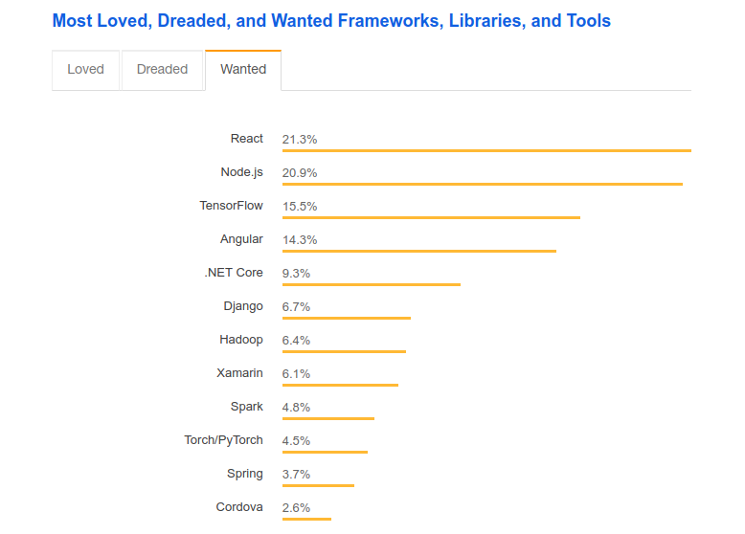
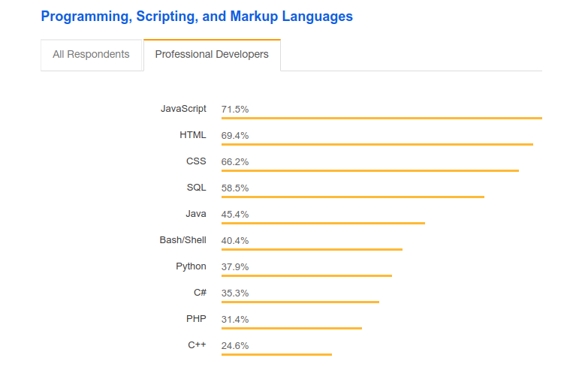
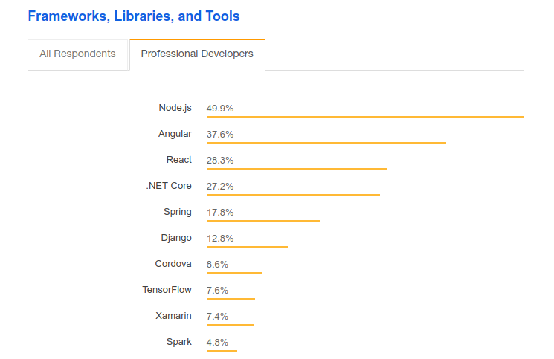
Conclusion
Functions
JS Objects
Engines
History
call(),apply(),bind()
Execution Context
Intro

